Slide 1
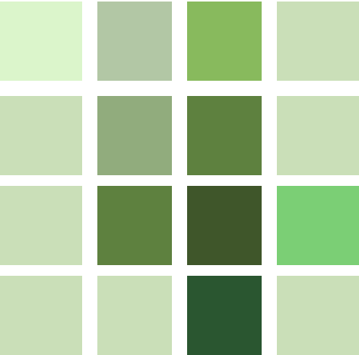
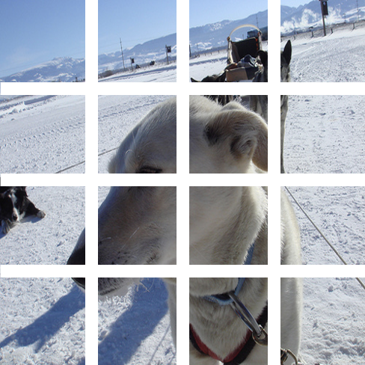
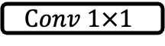

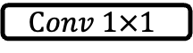
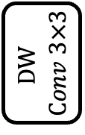

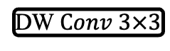

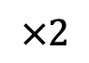

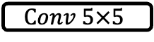
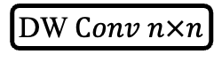
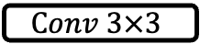

$$×2$$
DW $Conv n×n$
Channel-att.
Sigmoid
Reshape
Global
Channel-mixer
Context
$$Conv 1×1$$
$$Conv 5×5$$
GELU
GELU
LN
bottleneck
$$Conv 3×3$$
Info.
$$ℕ$$
$$Conv 1×1$$
normalize
DW $Conv 3×3$
GAP
Spatial-att.
(c) Spatial-Att.
(d) Channel-Att.
similarity
Token-mixer
pool
LN
$$DW$$
$$Conv 3×3$$
$$Conv 1×1$$
$$GELU$$
$$Dropout$$
$$Conv 1×1$$
$$Dropout$$
(a) FCVT Block
(b) FCVT Token-mixer
(d) FCVT Channel-mixer

Slide 2
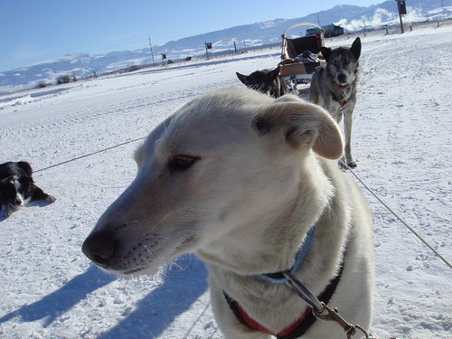
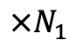
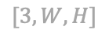
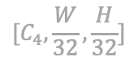
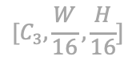
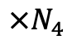
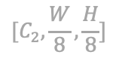
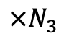
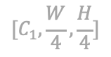
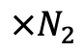
Stage 1
$$[C_{1},\frac{W}{4},\frac{H}{4}]$$
Stage 2
$$[C_{2},\frac{W}{8},\frac{H}{8}]$$
Stage 3
$$[C_{3},\frac{W}{16},\frac{H}{16}]$$
Stage 4
$$[C_{4},\frac{W}{32},\frac{H}{32}]$$
Image
GAP + FC
$$[3,W,H]$$
FCViT
Blocks
FCViT
Blocks
FCViT
Blocks
FCViT
Blocks
Overlapped Patch
Embedding
Overlapped Patch
Embedding
Overlapped Patch
Embedding
Overlapped Patch
Embedding
$$×N_{1}$$
$$×N_{2}$$
$$×N_{3}$$
$$×N_{4}$$

Slide 3

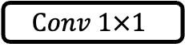
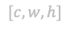
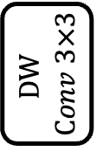
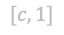
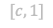


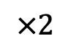
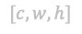

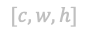
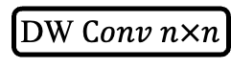

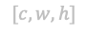
$$×2$$
$$[c,w,h]$$
$$Conv 1×1$$
FC
Channel-mixer
DW $Conv n×n$
$$[c,w,h]$$
Global
compete
Context
LN
FC
normalize
$$[c,1]$$
N
bottleneck
Info.
(c) Competitive Information Bottleneck
Token-mixer
$$[c,w,h]$$
$$[c,1]$$
similarity
pool
LN
$$DW$$
$$Conv 3×3$$
$$[c,w,h]$$
$$Conv 1×1$$
$$GELU$$
$$Dropout$$
$$Conv 1×1$$
$$Dropout$$
(a) FCViT Block
(b) FCViT Token-mixer
(d) FCViT Channel-mixer

Slide 5
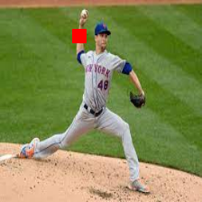
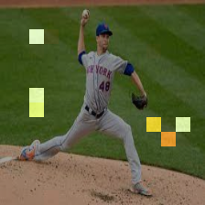
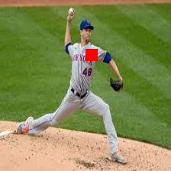

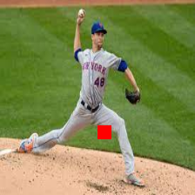
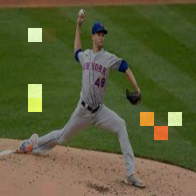
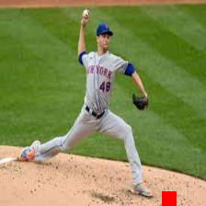
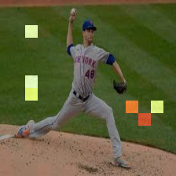
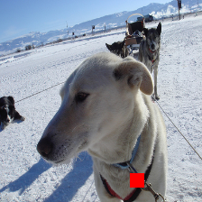
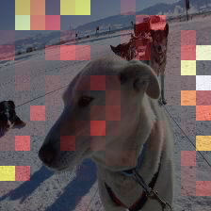

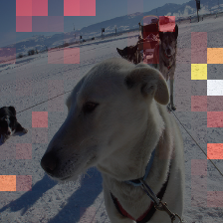
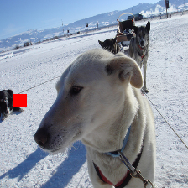
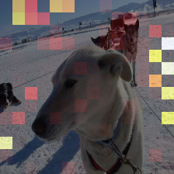

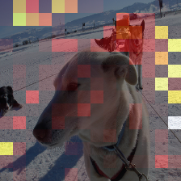
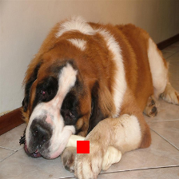
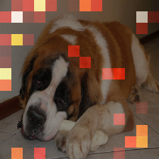
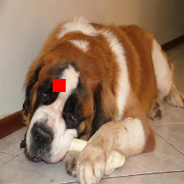
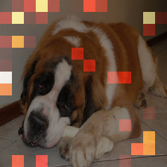
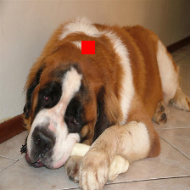
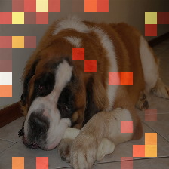
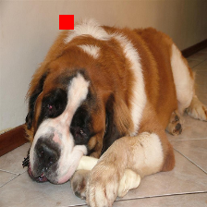









ViT-B
ViT-L
DeiT-B
DeiT-B-Distill

Slide 6































































8 groups in FCVT_64_B12
8 heads in ViT-base

